Slide 1
BookVerse-SMART LIBRARY MANAGEMENT SYSTEM
Capstone Project Presentation
VII Semester | School of CS&AI | SR University
Project Guide: Dr. A. Ramesh Babu, Associate Professor

Slide 2
PROJECT TEAM MEMBERS
• Kommu Madhupriya- 2303A51583
• Bandi Akhiranandhini- 2303A51516
• Jakkaraju Trishala-2303A51514
• Sandesari Keerthi-2303A51635
• Alli Harika-2303A510i7

Slide 3
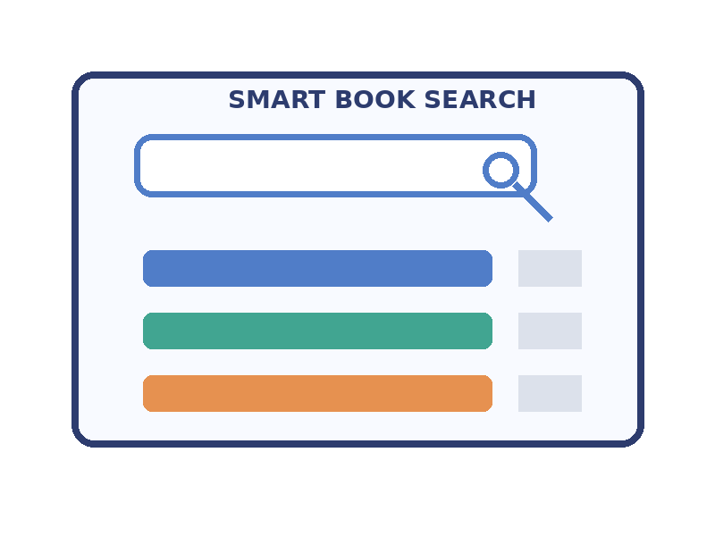
1. PROBLEM IDENTIFICATION
• Traditional libraries require manual searching and physical visits.
• Limited access may depend on time and location.
• Book discovery can be difficult without advanced search.
• Reading progress is not easily tracked in basic systems.
• Personalised recommendations and intelligent support are limited.

Slide 4
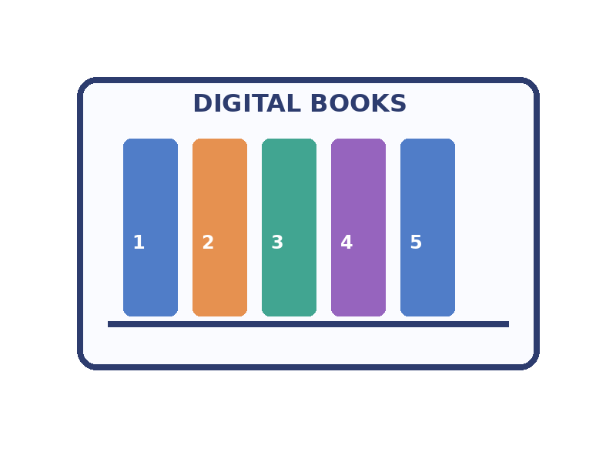
2. LITERATURE REVIEW
• Existing digital libraries provide online access to books and resources.
• Basic systems mainly focus on search and book management.
• Cloud technology supports secure authentication and data access.
• Recommendation systems improve personalised book discovery.
• Modern platforms include analytics and intelligent assistance.

Slide 5
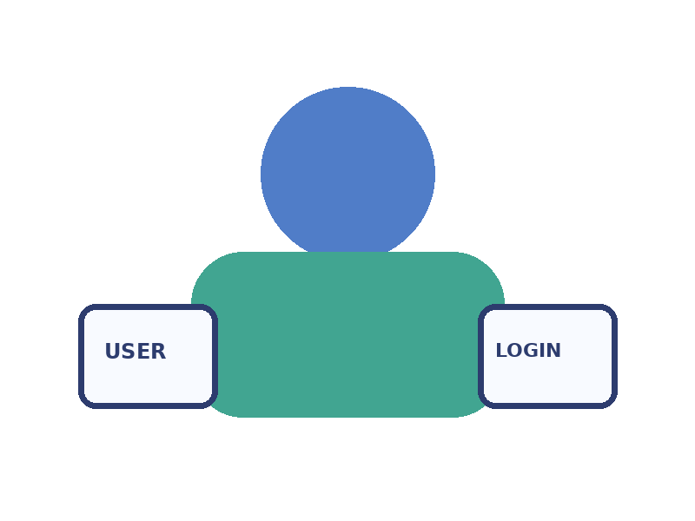
3. OBJECTIVES OF THE PROBLEM
• Develop a smart digital library platform for students and faculty.
• Provide secure authentication and user management.
• Enable advanced search and easy book discovery.
• Generate personalised book recommendations.
• Track reading activity and provide analytics.
• Support chatbot assistance, reviews and notifications.

Slide 6
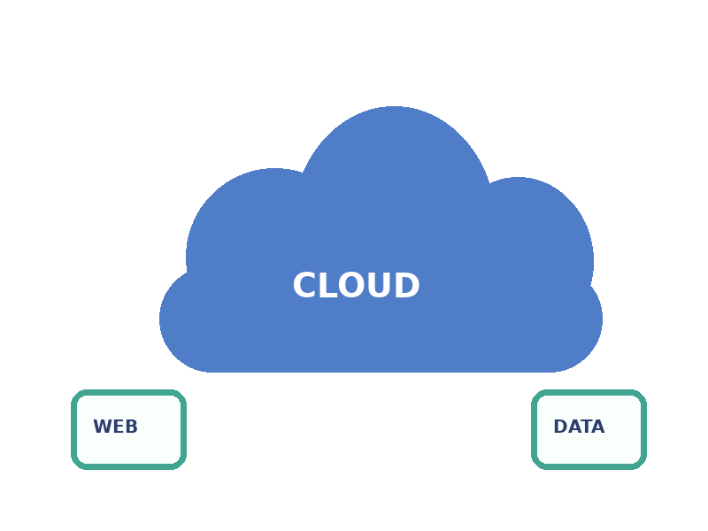
4. PROPOSED PLAN
• Step 1: Develop a simple and responsive web interface.
• Step 2: Implement secure Firebase Authentication.
• Step 3: Add advanced search and book discovery.
• Step 4: Generate personalised recommendations.
• Step 5: Provide chatbot assistance and reading analytics.
• Step 6: Maintain book information using JSON/CSV datasets.

Slide 7
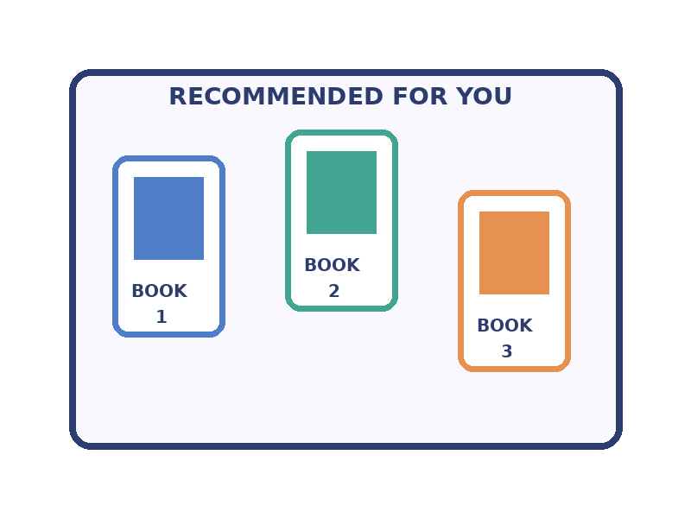
5. EXISTING METHODS VS PROPOSED METHOD
• Existing method: Manual or basic book search.
• Proposed method: Advanced search and smart book discovery.
• Existing method: Limited recommendations.
• Proposed method: Personalised recommendations.
• Existing method: No intelligent support.
• Proposed method: Chatbot, analytics, reviews and notifications.

Slide 8
KEY FEATURES OF BOOKVERSE
• Authentication for secure user access.
• Advanced search for easy book discovery.
• Recommendations for personalised book suggestions.
• Reading analytics for tracking reading activity.
• Chatbot assistance for user support.
• Reviews and notifications for better interaction.

Slide 9
TECHNOLOGIES USED
• HTML, CSS and JavaScript for frontend development.
• Firebase Authentication for secure login.
• Firebase / Cloud services for application support.
• Vercel for deployment.
• JSON / CSV for maintaining book metadata.

Slide 10
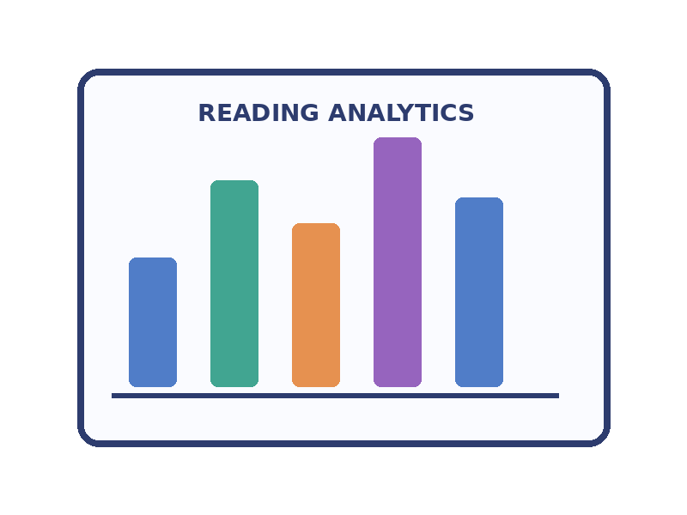
ADVANTAGES
• Easy access to digital library resources.
• Saves time through faster search and discovery.
• Personalised learning through recommendations.
• Better engagement through chatbot, reviews and notifications.
• Useful insights through reading analytics.

Slide 11
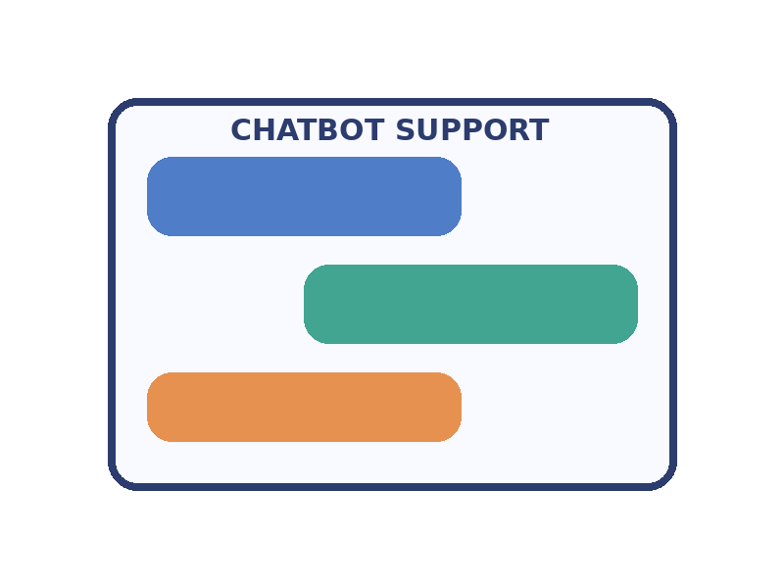
FUTURE ENHANCEMENTS
• Advanced AI based recommendation models.
• Improved chatbot with better intelligent assistance.
• Mobile application for easier access.
• More digital resources for students.
• Admin dashboard for library management.

Slide 12
CONCLUSION
• BookVerse is a smart digital library platform.
• It combines authentication, search, recommendations and analytics.
• It improves the traditional library experience.
• The system provides a convenient platform for students and faculty.

Slide 13
THANK YOU
Questions?

